Slide 1

Project Final Review for the award of Bachelor of Technology
DESIGN AND ANALYSIS OF RECTANGULAR MICROSTRIP PATCH ANTENNA FOR 5G APPLICATIONS USING HFSS
Under The Guidance of
K.Vijaya Lakshmi, M.Tech.
Assistant Professor.
Batch No: A 01
Project Associates :
J. Chandravathi – 219Y1A0456
B. SaiKiran – 219Y1A0411
C. Lavanya – 219Y1A0430
C. Akhil – 219Y1A0433
C. KishoreKumar – 219Y1A0429
Department of Electronics and Communication Engineering
2024-2025

Slide 2
Abstract
This work focuses on the design and fabrication of a rectangular microstrip patch antenna employing an inset feed for 5G applications, utilizing an FR4 epoxy substrate.
The antenna is engineered to function at 27 GHz and is fine-tuned to achieve high gain and efficiency. Simulations reveal a gain of 5.29 dB and an efficiency of 78.85%.
The findings are compared with prior studies, emphasizing the balance between gain, efficiency and the choice of substrate material.
The use of an inset feed technique contributes to improved impedance matching, reduced reflection coefficient, and enhanced current distribution across the patch, thereby boosting overall radiation efficiency.
While this work is currently limited to the design and simulation phase, the results indicate that the proposed antenna design holds significant potential for practical 5G applications.

Slide 3
Objective of the project work
The objective of this project is to design, simulate and fabricate a rectangular microstrip patch antenna tailored for 5G wireless communication applications using ANSYS HFSS. The work focuses on:
Developing a compact and efficient antenna structure suitable for 5G integration.
Performing simulation-based analysis to evaluate parameters such as return loss, bandwidth, gain, radiation efficiency and VSWR.
The design process emphasizes minimizing signal reflection, maximizing radiation efficiency, and achieving wideband characteristics suitable for high-speed 5G networks.
After simulation, the antenna is fabricated and tested to validate the theoretical results and assess its practical applicability.
This work not only enhances understanding of advanced antenna design but also contributes to the development of reliable hardware solutions for modern wireless systems

Slide 4
Brief description of the work
In this project, the rectangular microstrip patch antenna is designed to operate 27GHz, which lies within the mm Waveband (24.25-29.5GHz), part of 5G Frequency Range 2.
Selected suitable substrate material for 27 GHz operation.
Calculated antenna dimensions using standard design equations.
Designed and simulated the rectangular microstrip patch antenna using ANSYS HFSS.
Analyzed key performance parameters like Return Loss (S11), VSWR, Gain, Band width.
Optimized the design through simulation.

Slide 5
Need of the project work
The rise of 5G demands high-performance antennas operating at mmWave frequencies like 27 GHz.
Conventional antennas face challenges at high frequencies, such as poor efficiency and high return loss.
A microstrip patch antenna offers a compact, low-cost, and efficient solution for 5G integration.
Simulation using ANSYS HFSS ensures accurate performance analysis and design optimization.
Bridging simulation and real-world performance through fabrication validates design effectiveness.
Supports development of compact, high-gain antennas critical for next-gen wireless systems.

Slide 6
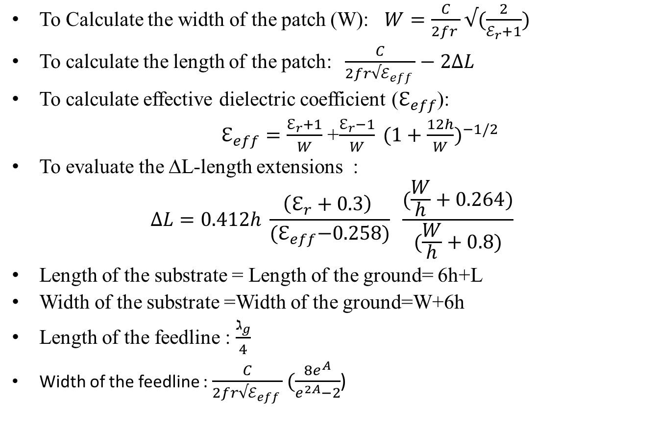
Mathematical Equations
To Calculate the width of the patch (W): $W=\frac{C}{2fr }√(\frac{2}{ℰ_{r}+1})$
To calculate the length of the patch: $\frac{C}{2fr√ℰ_{eff} }−2∆L$
To calculate effective dielectric coefficient ($ℇ_{eff}$):
$ℇ_{eff}=\frac{ℇ_{r}+1}{W}$ +$\frac{ℇ_{r}−1}{W} ({1+\frac{12h}{W})}^{−1/2}$
To evaluate the ∆L-length extensions :
$$∆L=0.412h \frac{\left(ℇ_{r}+0.3\right) }{{(ℇ}_{eff}−0.258)} \frac{(\frac{W}{h}+0.264)}{(\frac{W}{h}+0.8)}$$
Length of the substrate = Length of the ground= 6h+L
Width of the substrate =Width of the ground=W+6h
Length of the feedline : $\frac{ℷ_{g}}{4}$
Width of the feedline : $\frac{C}{2fr√ℰ_{eff} }(\frac{8e^{A}}{e^{2A}−2}$)

Slide 7
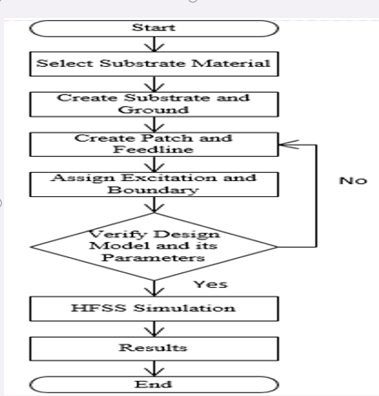
Flow Chart

Slide 8
Parameters used to design antenna
Parameters | Value (mm)
Length of the patch | 16.7
Width of the patch | 21.6
Length of the ground | 14.28
Width of the ground | 19.86
Length of the substrate | 14.28
Width of the substrate | 19.86
Length of the feedline | 1.56
Width of the feedline | 5.60

Slide 9
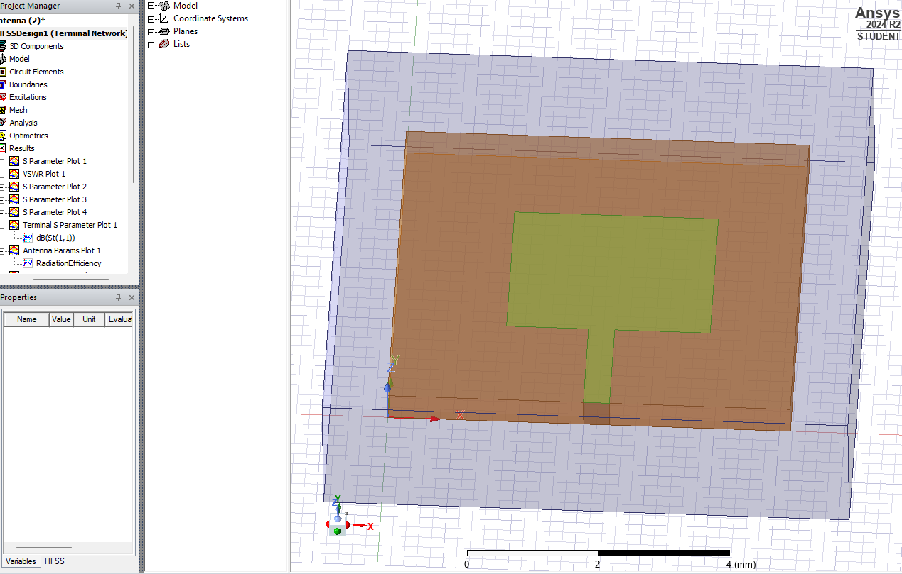
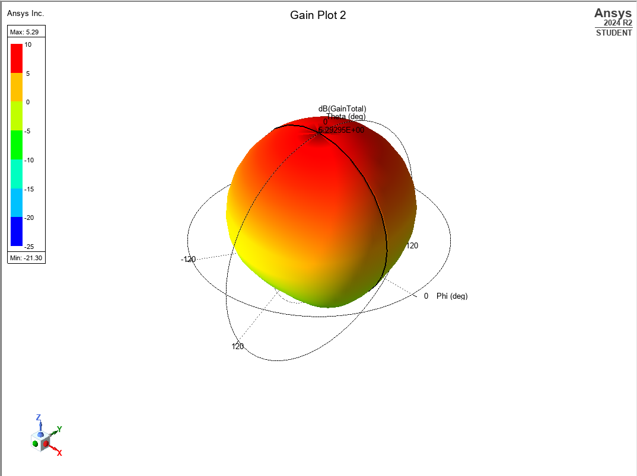
Simulation & Results
Simulation Gain

Slide 10
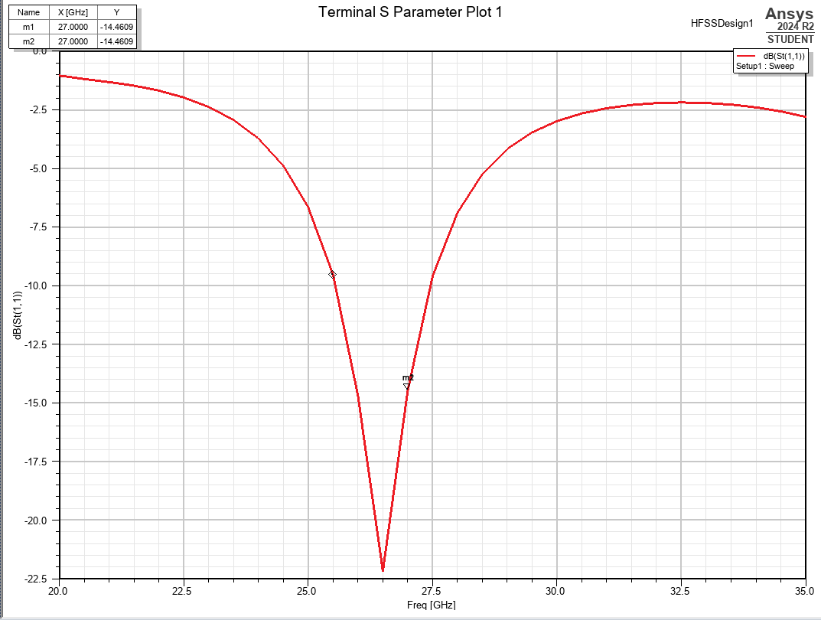
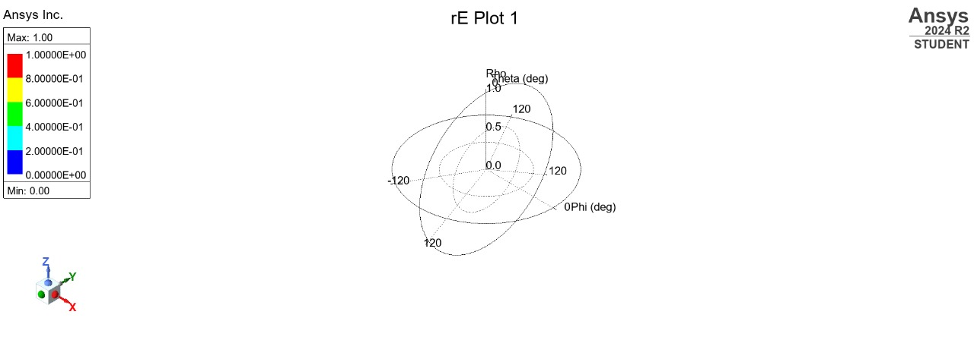
Return Loss Radiation Pattern

Slide 11
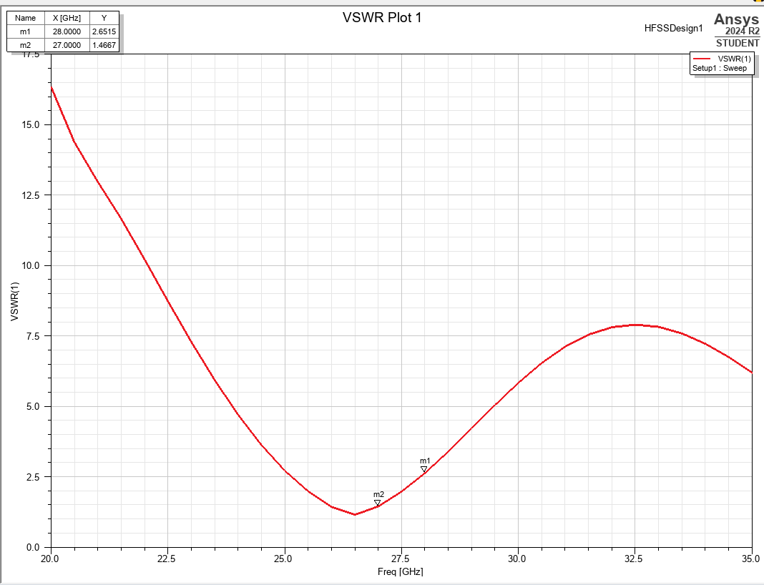
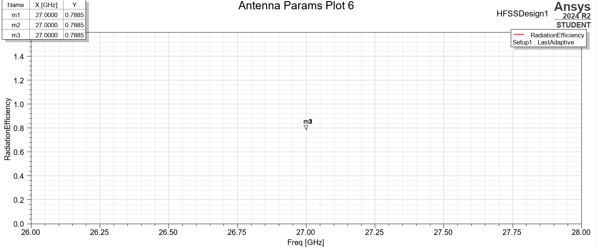
VSWR Radiation Efficiency

Slide 12
Societal relevance
Supports 5G Expansion: The project contributes to the development of compact and efficient antennas, which are essential for deploying high-speed 5G networks—the backbone of future communication systems.
Enables Smart Infrastructure: 5G antennas like this one can be integrated into smart cities, improving real-time data transfer for traffic management, remote healthcare, IOT, and public safety systems.

Slide 13
Conclusion and future scope
The rectangular microstrip patch antenna, developed and evaluated using advanced high-frequency simulation tools, exhibits outstanding performance at a resonant frequency of 27 GHz. This renders it highly suitable for contemporary communication systems, especially within the domain of 5Gtechnology.
The antenna achieves a measured gain of 5.29 dB, a Voltage Standing Wave Ratio (VSWR) of 1.46, and a return loss of-14.46 DB. Additionally, it delivers a bandwidth of 970 MHz and an efficiency of 78.85%.
Future stages of the project will focus on testing and validating the antenna's performance using real-world measurements, comparing the results with the simulation data

Slide 14
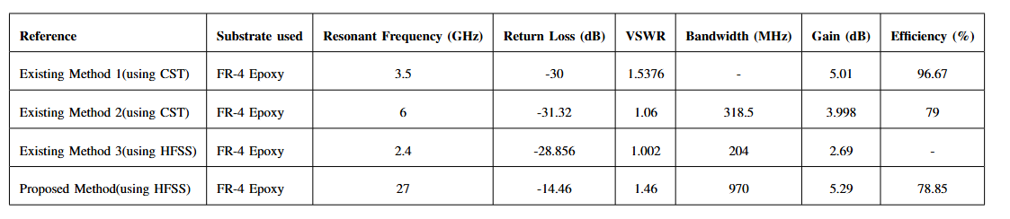
Comparison of proposed and existing methods

Slide 15
References
Nayla Ferdous, Goh Chin Hock, Said Atul Hamidah A. Hamid, M. Nazri A. Raman, Tiong Sieh Kiong and Mahamood Ismail ”DESIGN OF ASMALL PATCH ANTENNA AT 3.5 GHZ FOR 5G APPLICATION”, Volume 268,DOI 10.1088/1755-1315/268/1/012152.
S. Bala, Z. Yunusa, S. A. Babali "Design and Analysis of a Rectangular Microstrip Patch Antenna using Different Dielectric Materials for Sub-6GHz 5G Applications" ,Nigerian Journal of Engineering, Vol. 28, No. 2, August 2021, ISSN (print): 0794 – 4756, ISSN(online):2705-3954
Rashmi N,Lakshmisagar H S, " Design, Simulation and Fabrication Analysis of Rectangular Patch Antennas for Enhanced Performance", September 9th, 2024
S. Sridevi and K. Mahendran, “Design of Millimeter Wave Microstrip Patch Antenna for MIMO Communication,” International Research Journal of Engineering and Technology, vol. 04, no. 10, pp. 1513–1518, 2017

